Slide 1


Master’s thesis presentation by Henrik Bergersen
26.02.2026
Supervisors:
DTU: Bent Lauritzen, Amalia Chambon
AFRY: Jarl Robert Heer

Slide 2
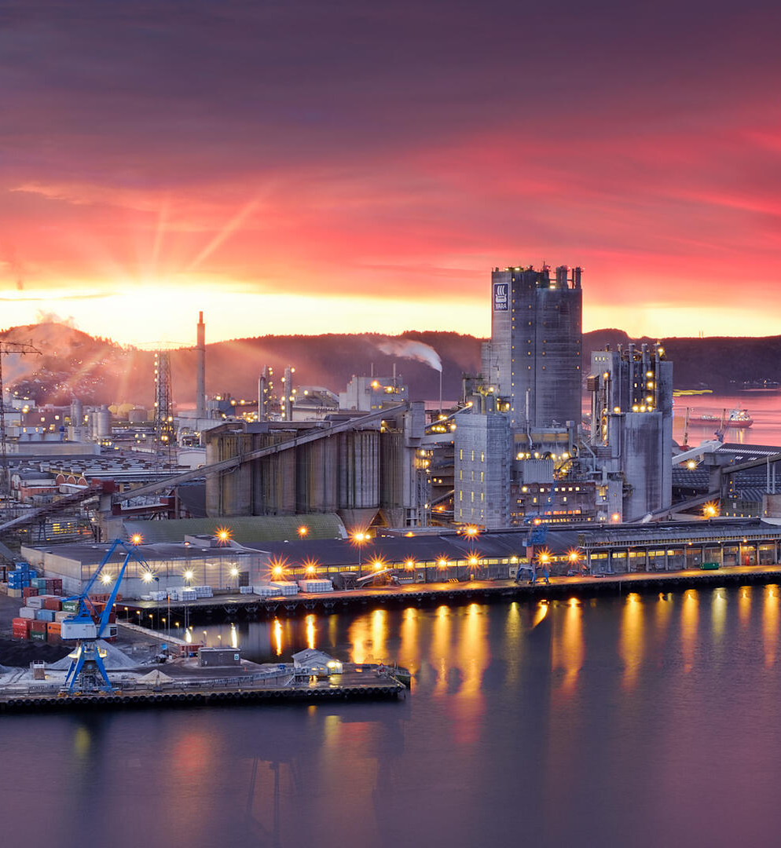
Cogeneration of Power and Ammonia in Europe using Small Modular Pressurized Water Reactors
A Techno-Economic Analysis & Operational Strategy Optimization

Slide 3
Table of contents
Background
Objective
Theory
Methodology
Results
Conclusion

Slide 4
Background
Nuclear reactors operate most efficiently as baseload providers, where reducing output in response to price fluctuations leads to fuel underutilization. Giorgio Locatelli et al.
Cogeneration might serve as a mechanism to decouple the reactor power from grid demand and increase profitability. IAEA 2019
The ammonia market is a mature industry with 70% used for fertilizer, and additional expansion is projected into the low-carbon fuel sector. IEA 2021
Conventional ammonia synthesis relies on natural gas and offers opportunities for decarbonization. HydrogenEurope 2023
Small Modular Reactors have gained attraction in recent years for their potential lower upfront cost and site flexibility. IAEA 2024

Slide 5


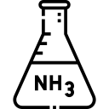
Objective
Investigate the techno-economic potential of deploying small modular pressurized water reactors for cogeneration of power and green ammonia within the European power market.
Power
SMR plant
Ammonia

Slide 6
Theory on nuclear cogeneration

Slide 7
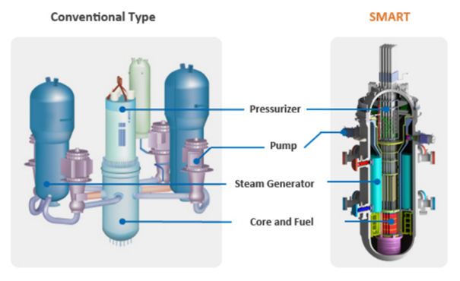
Small modular pressurized water reactor
iPWR is the most prominent type of SMR. C. Zeliang et al.
Illustration: djysrv 2020

Slide 8
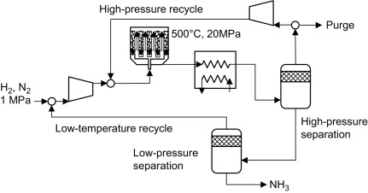

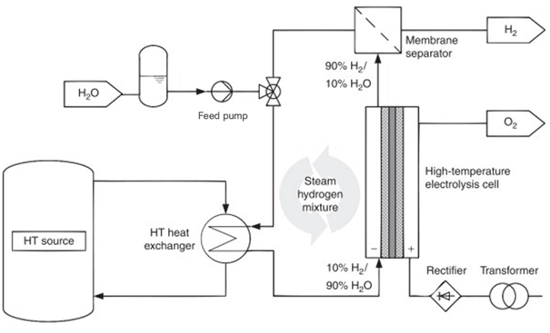

Green ammonia synthesis
Image: S. Mitsushima et al.
High-Temperature Steam Electrolysis
Haber Bosch
Image: T. Smolinka

Slide 9

Haber Bosch Process
Operates at high pressures and temperatures for process optimization
Hydrogen from electrolysis
Nitrogen from Pressure Swing Adsorption (PSA)
Catalytic reaction
Reactor

Slide 10
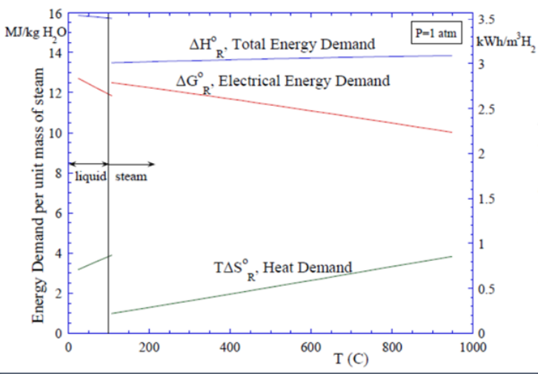

High-Temperature Steam Electrolysis
Replacing conventional Steam Methane Reforming with electrolysis
Uses steam for reduced electrical input (Gibbs energy)
Solid-Oxide Electrolysis Cells operates at 500-850ºC Kumar et al.
Image: INL 2010

Slide 11
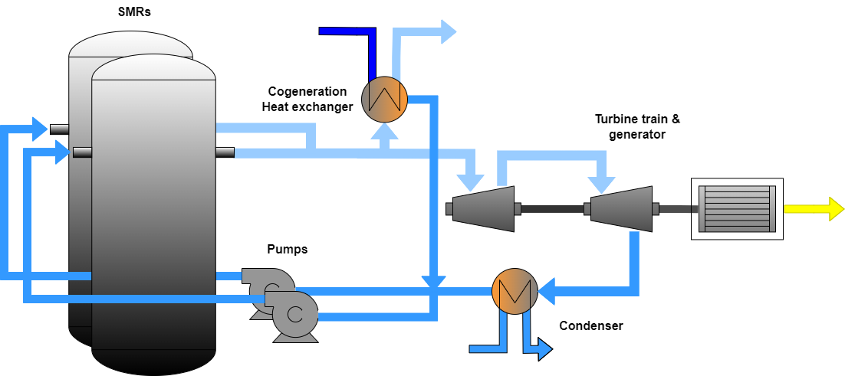
Cogeneration
Cogeneration by diverting steam from the secondary steam loop. IAEA 2019
Continuous production of both power and ammonia to ensure operational stability. NEA 2011
Own illustration

Slide 12
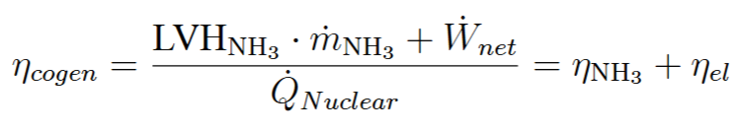
Cogeneration efficiency

Slide 13
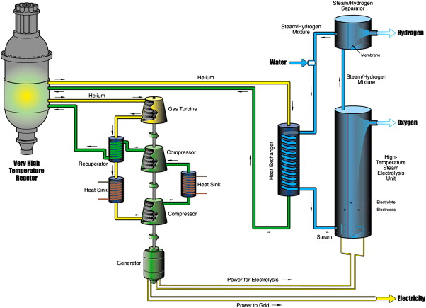
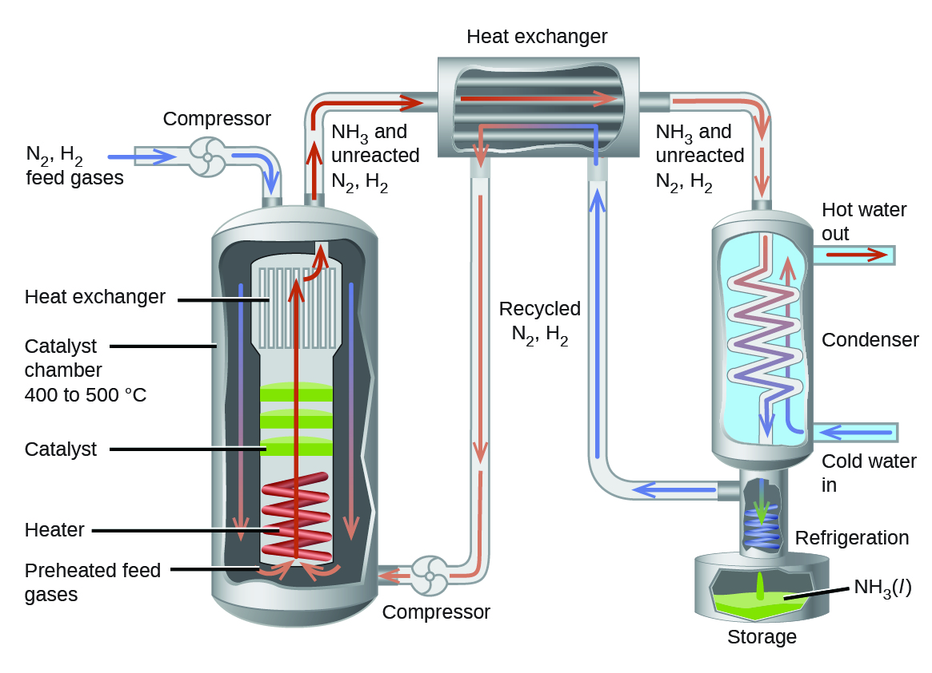
Cogeneration of power & green ammonia diagram
Electrolysis
Haber Bosch (Ammonia synthesis)
Steam extraction
Steam
Small Modular Pressurized Water Reactor
Reactors supply power to entire system

Slide 14
Theory on techno-economic analysis

Slide 15
Total revenues from power and ammonia

Slide 16
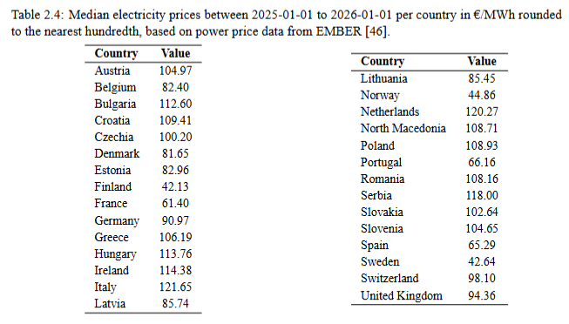
Power prices in Europe
Ember 2025

Slide 17
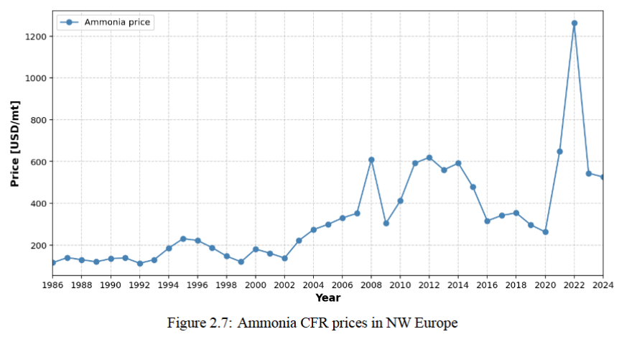
Ammonia prices in Europe
Data: Argus ammonia 2025
In 2025:
Blue ammonia 590 – 770 €/t
Green ammonia 800 – 1000 €/t
Source: businessanalytiq, Imarcgroup, SP-global

Slide 18
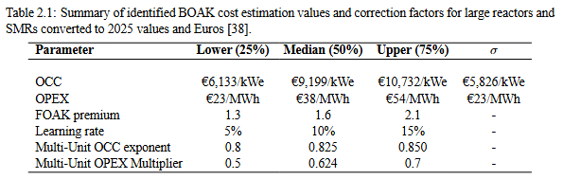
Production costs
INL: literature review of advanced reactor cost estimates
Richard Turton et al. Analysis, Synthesis, and Design of Chemical Processes.

Slide 19
Methodology
Thermodynamic model developed using DWSIM chemical process simulator
Simulated loads from 200 to 700 tons per day (tpd) of ammonia
Techno-economic analysis based on the marginal break-even electricity price using:
Median values for the OPEX (38 €/MWh) and MOM (0.625) of SMRs.
Operating cost of ammonia production estimated for a nominal capacity of 500 tpd.
Nuclear reactor supplies power to all process equipment
Capacity factor of 90%

Slide 20
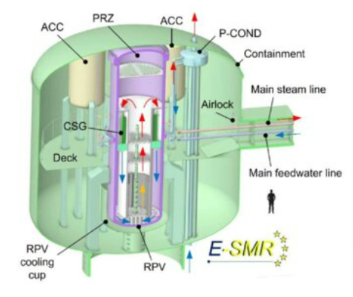
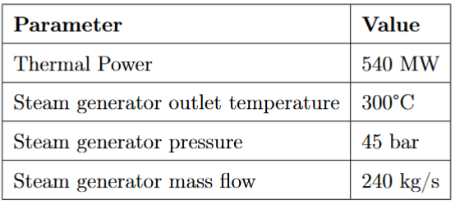
Reactor model based on European-SMR
European Small Modular Reactor (E-SMR) – Tandem Euratom project
Tandem 2023
Notes:
Øyeblikksbildet av hva jeg ser på, men kan hende jeg dropper noen etterhvert

Slide 21
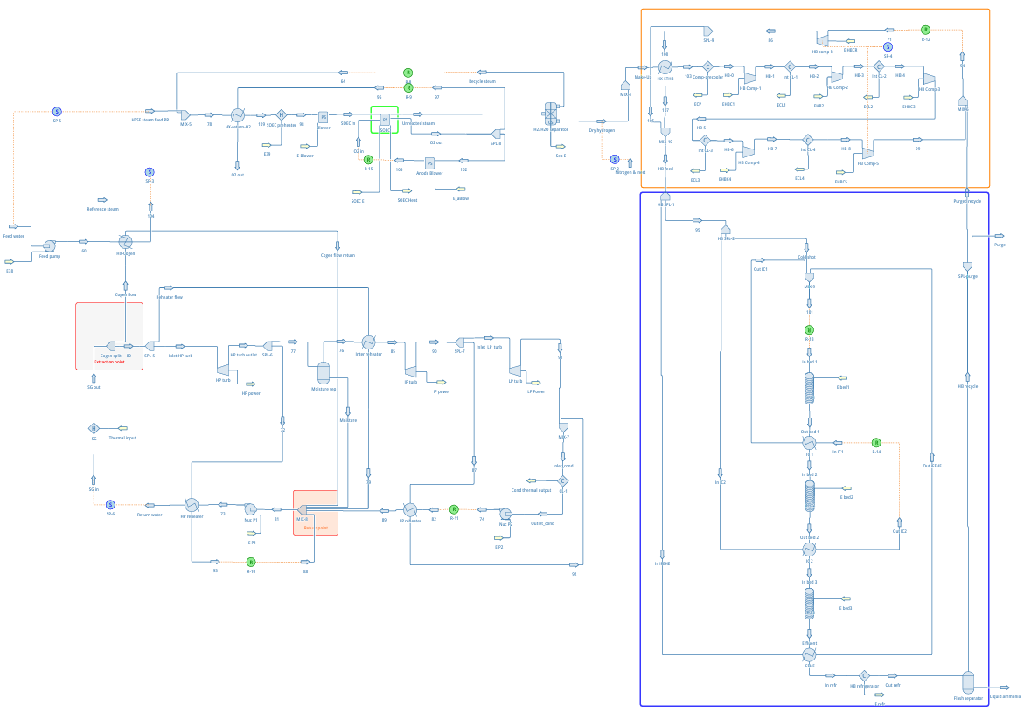
Thermodynamic model
Multi-stage compression
HTSE
H2+N2
Steam extracted before turbine train
Electrolysis feed water superheated to 230 C at 1 bar.
HTSE operated at 750 C and atmospheric pressure.
230
H2O
300 C
Secondary steam loop
NH3
Haber Bosch

Slide 22



Marginal Break-Even Electricity price
Power revenues
Ammonia revenues
Generally:

Slide 23
Results

Slide 24
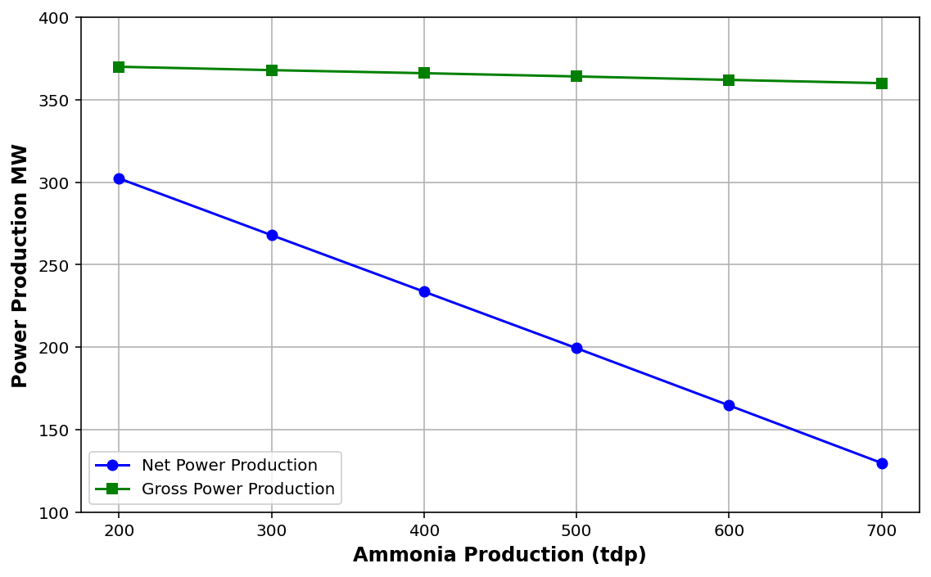
Power & ammonia production with 2 E-SMR units
One SMR unit can supply power up to 453.8 tpd.

Slide 25
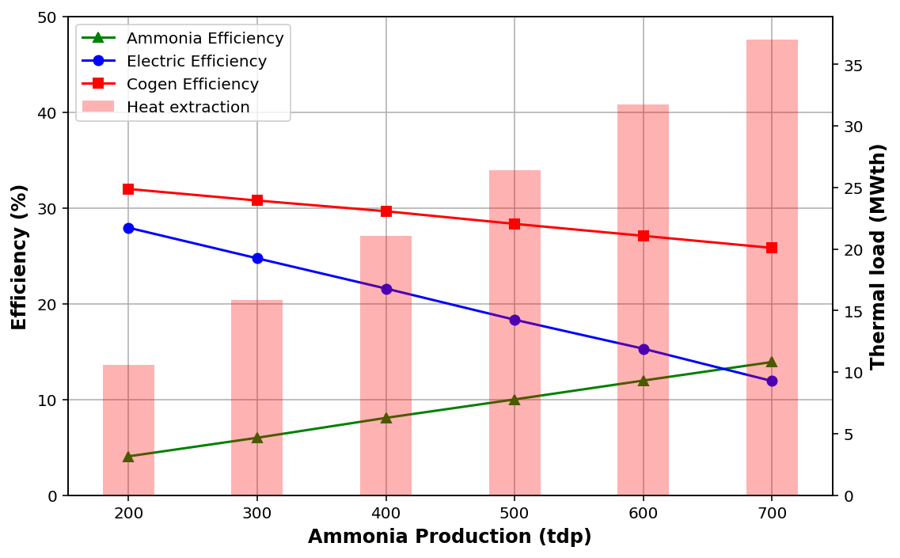
Thermal to net electric, ammonia, and cogeneration efficiency

Slide 26
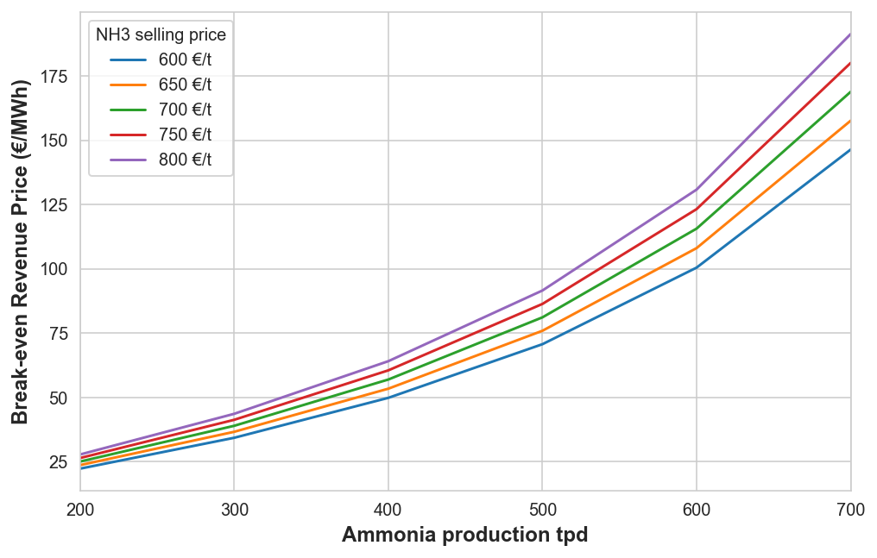
Marginal break-even electricity price
(500 tpd nominal load)

Slide 27
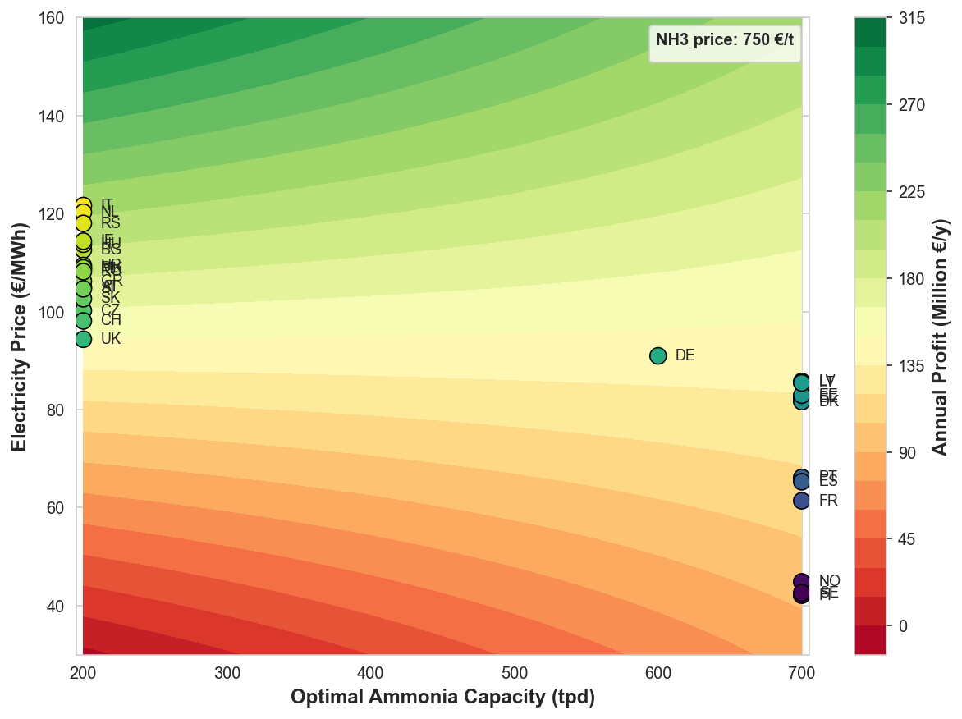
Maximized profits per market
(500 tpd nominal load)

Slide 28
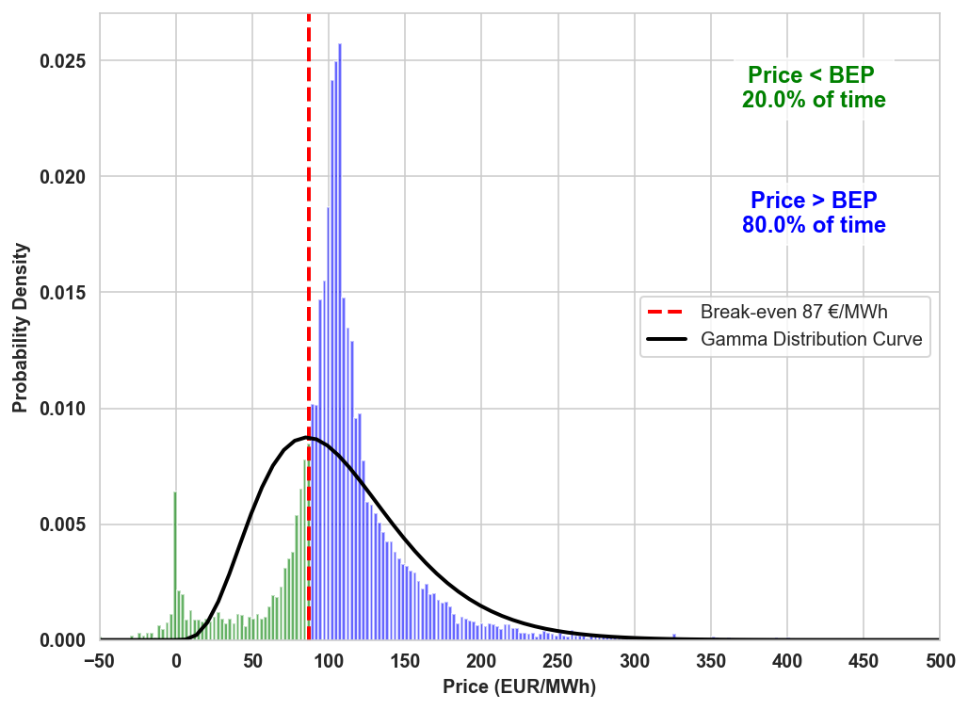
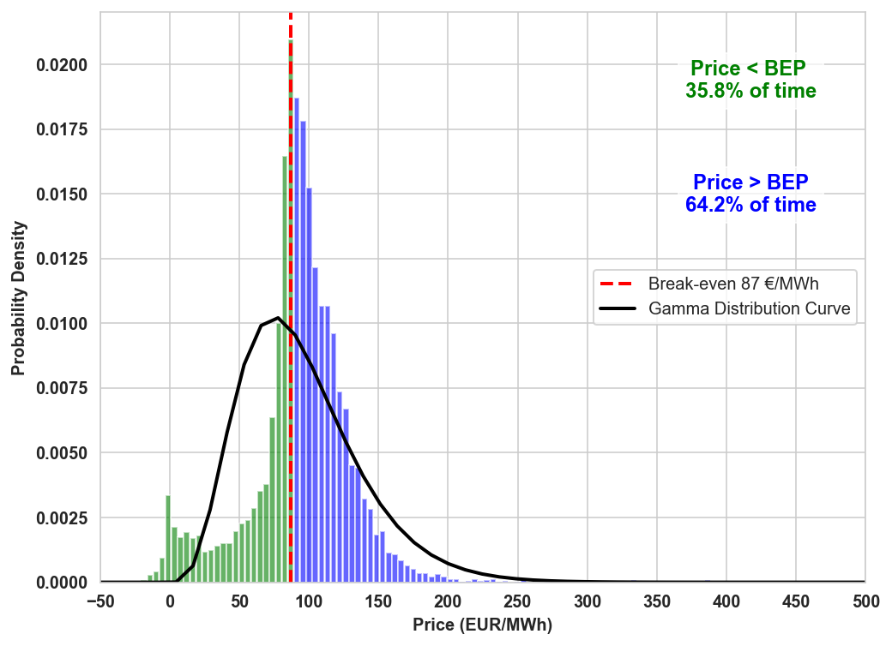
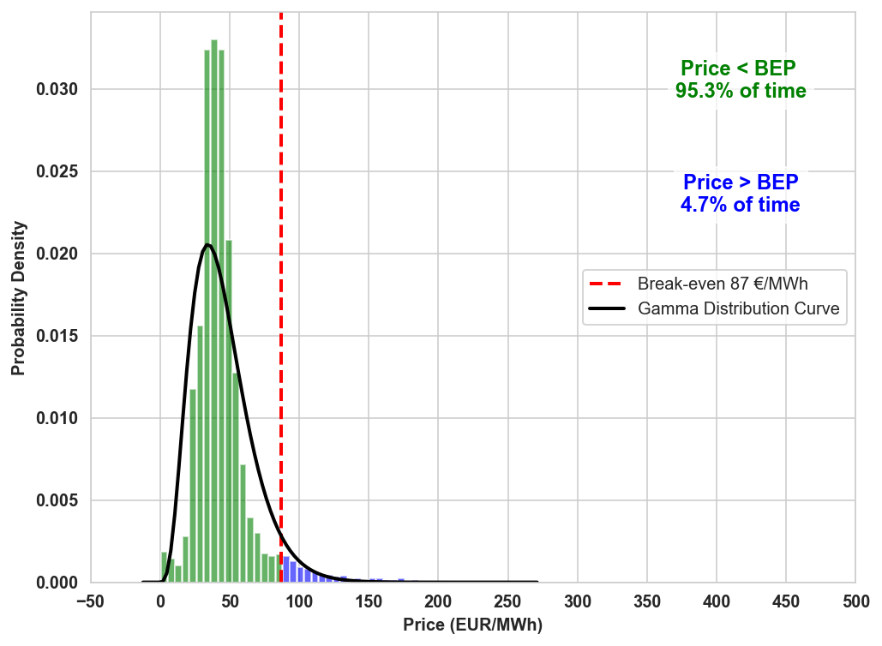
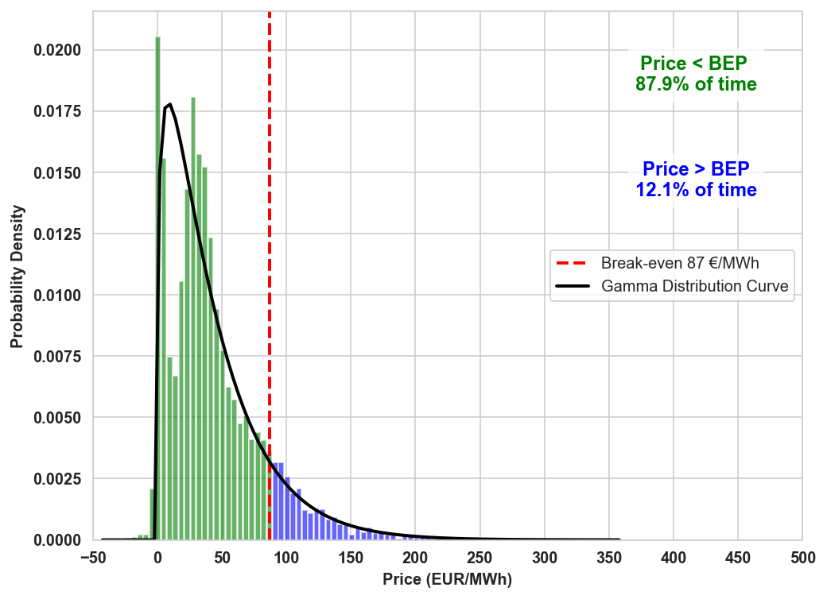
Mode of operation based on market volatility
Poland
United Kingdom
Frequency of 2025 power prices in each market.
MBEP at nominal capacity (500 tpd) and an ammonia price of 700 €/t.
Norway
Sweden

Slide 29
Conclusion
Multiple SMRs are required to supply sufficient energy to the entire facility when ammonia capacity exceeds 453.8 tpd.
Cogeneration efficiency decreases with increasing ammonia production
At nominal capacity and an ammonia price of 700 €/t, ammonia production is more profitable than power production over 90% of the operating hours in the Norwegian market, 80% in the Swedish market, and 70% in the Finnish market.
Indicates that cogeneration of power and medium-scale ammonia production is more profitable compared to only power production in North Europe, and in other regions with similar low power prices, despite lower system efficiencies.

Slide 30
Thank you

Slide 31
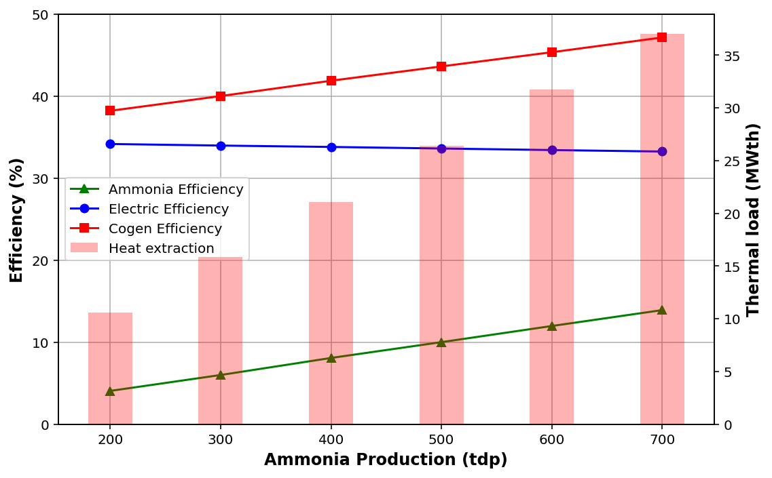
Efficiencies (Gross electric production)

Slide 32
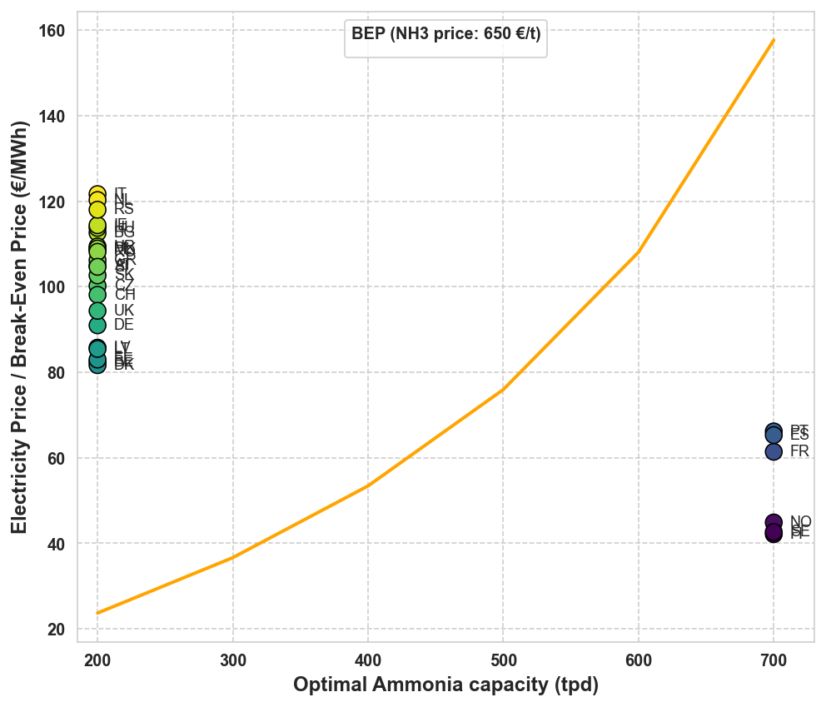
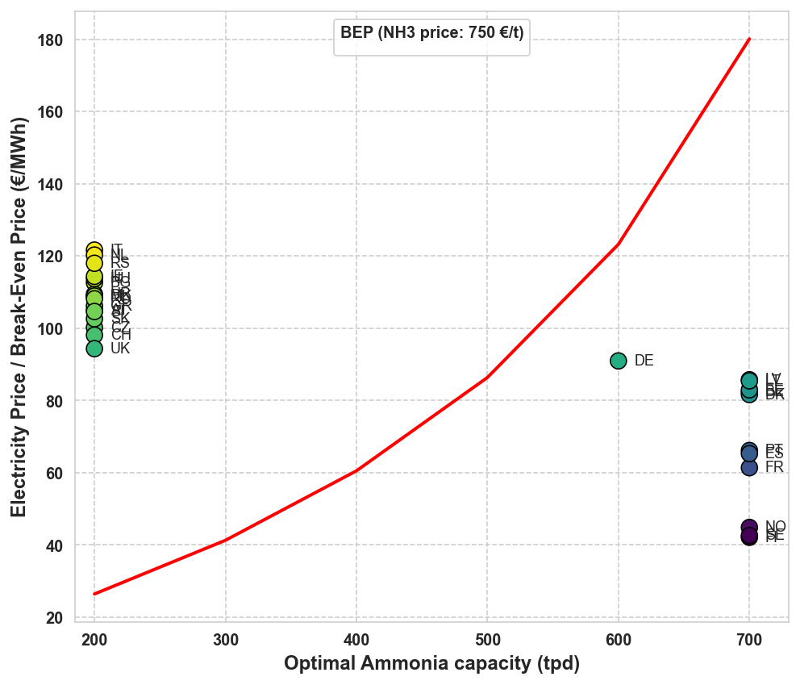
Optimal ammonia capacity
(500 tpd nominal load)

